Slide 1

4. Noise and Dimensionality
Dr. David R. Thompson
Jet Propulsion Laboratory, Imaging Spectroscopy Group
July 20, 2019

Slide 2
Goals for this module
Interpret variance and covariance
Estimate covariance matrices from spectroscopic data
Understand, calculate, and interpret the intrinsic spectral dimensionality

Slide 3
In a natural physical system, random measurement noise often introduces a regularization effect.
Ideal measurement
Realized measurement
channel 2
channel 2
channel 1
channel 1

Slide 4
The intrinsic dimensionality represents the true degrees of freedom in the measured process.
channel 2
channel 1
This can be a measure of spectral diversity.

Slide 5
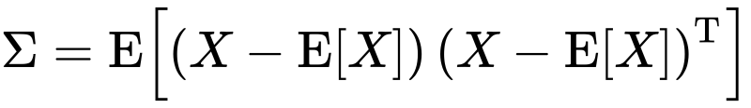
To estimate the intrinsic dimensionality measurable above the noise, look at the eigenvalues of the covariance matrix. Apply Singular Value Decomposition:
U is a valid orthonormal basis
Diagonal matrix of singular values – use instead of covariance matrix eigenvalues

Slide 6
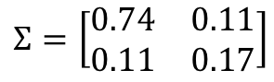
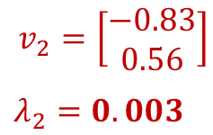
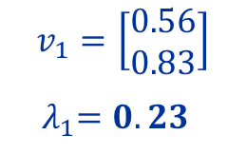
To estimate the intrinsic dimensionality measurable above the noise, look at the eigenvalues of the covariance matrix.
$$Σ=\left[\begin{matrix}0.74 & 0.11 \\ 0.11 & 0.17\end{matrix}\right]$$
channel 2
$$v_{1}=\left[\begin{matrix}0.56 \\ 0.83\end{matrix}\right]$$
${ λ}_{1}=0.23$
Only one significant eigenvalue
$$v_{2}=\left[\begin{matrix}−0.83 \\ 0.56\end{matrix}\right]$$
$λ_{2}=0.003$
channel 1

Slide 7
This eigenvalue decay curve tells you how many dimensions are “significant.”

Slide 8
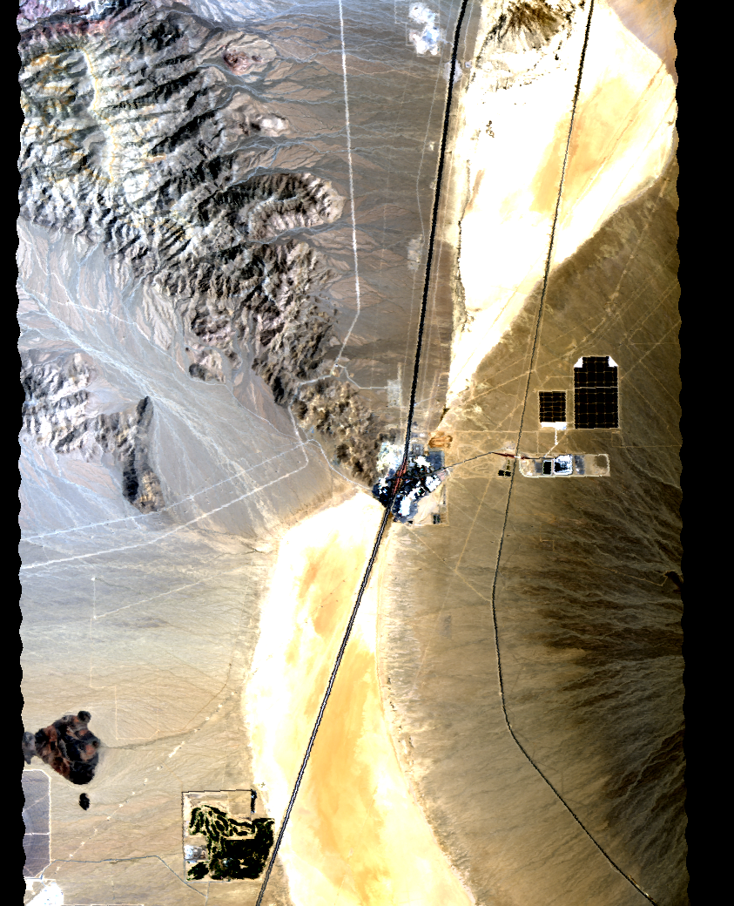
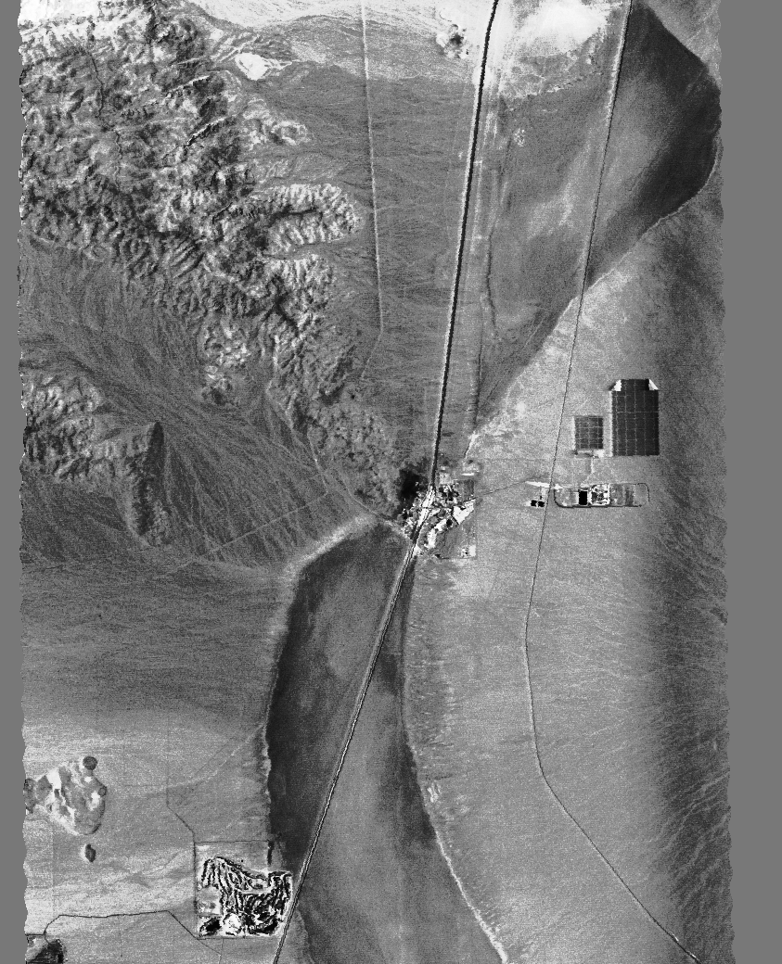
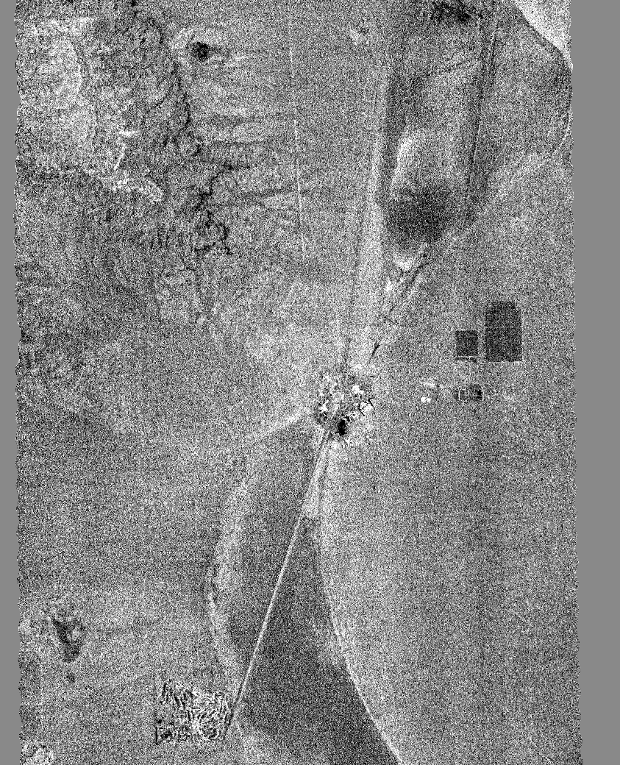
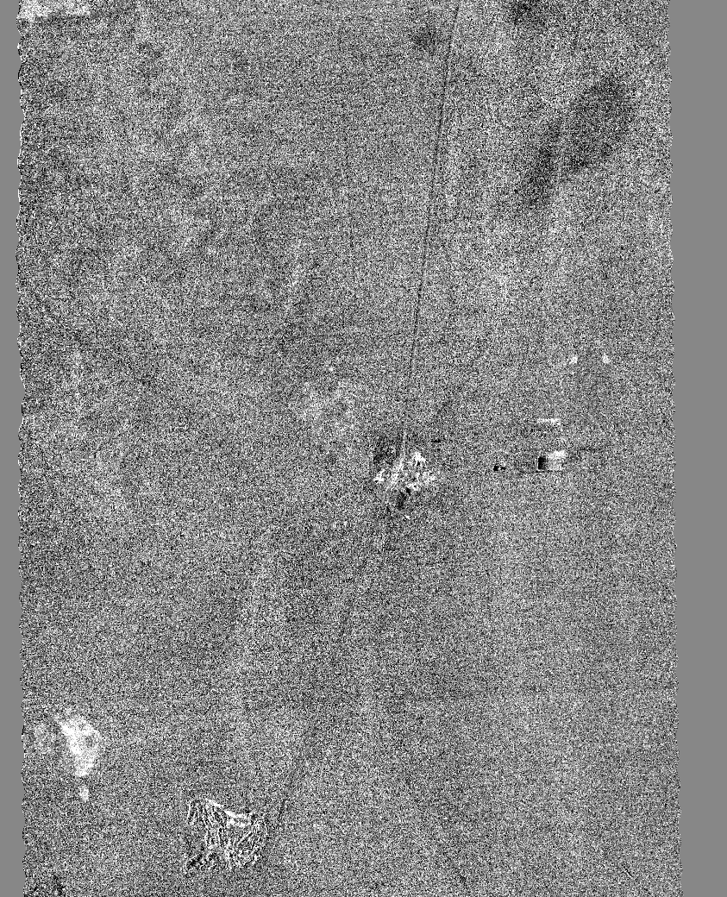
One way to find the noise level: project the data onto each eigenvector. Where does uncorrelated noise dominate?
We can define this dataset as having an intrinsic dimensionality of 24.
eigenvalue
component #
10
24
32
RGB
Scene dominates
Scene = Noise
Noise dominates
AVIRIS-C Overflight of Ivanpah Playa, 31 Mar 2014

Slide 9
Example from “AVIRIS Classic” Instrument

Slide 10


The Spectral Dimensionality of California
[Thompson et al., Optics Express 2016]
Images: Google / NASA / Sierra Nevada Photo by DAVID ILIFF. License: CC-BY-SA 3.0
Dimensionality
Spring 2013

Slide 12
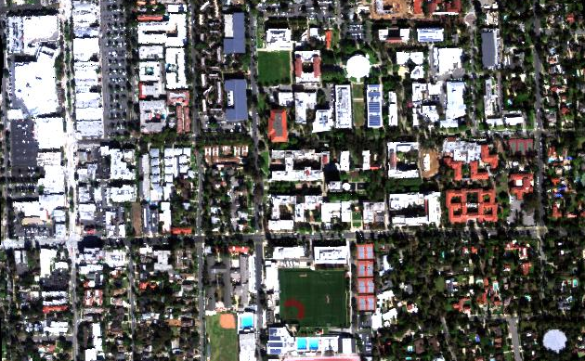
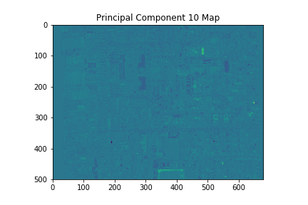
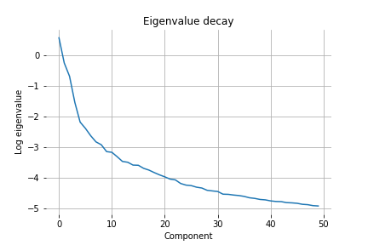
Exercise 4: Intrinsic dimensionality
N
Objective: Find the intrinsic dimensionality of the Caltech cube. Calculate principal components as before, and evaluate the eigenvalue decay. There are several ways one might find the noise level. For example:
Project each mean-removed spectrum onto the eigenvectors to make spatial maps. Then, visually determine the eigenvalues for which the spatial projection starts degenerating to noise.
Find a spatially-homogeneous area and use pixelwise differencing methods. I haven’t actually tried this yet, and it might be challenging due to the nature of the scene.
100 m

